Slide 1
3-Way Controlled Robotic Vehicle
Embedded Systems
Analysis
Ailton Lopes – A72852
Nuno Afonso – A65354

Slide 2
Agenda
Motivation
Market Study
Constraints and Requirements
System Overview
Hardware and Software Specification
Block Diagram
System Architecture
System Sequence Diagrams
Use Cases
Event Tables
State Diagrams
Technology Stack
Gantt Diagram

Slide 3
Motivation
Every year there are 2 million new wheelchair users
Some of them are unable to control parts of their body enough to physically control a traditional wheelchair
We are aiming to develop a robot controlled by three different input mechanisms

Slide 4
Problem’s Study
The direction of movement can be changed:
Moving the Controller downwards or upwards and to the left or right
Saying voice commands
In the Desktop Application
The user will be able to see the sensors information in the Desktop Application
The Robot will receive the commands and move accordingly to them

Slide 5
Functional Requirements
Give the user all the command option to control the Robot
The Robot system is able to work without the Desktop Application or the Controller
Give the user the possibility of choosing the Robot controller mode

Slide 6
Non-functional Requirements
High performance
Easy to upgrade adding other control mechanisms
Friendly user interface

Slide 7
Management Constraints
Group is composed by two elements
Budget for the project under 100€
Minimum of 6 hours of work a week for each group member
Finish within the specified deadlines
The project has duration of four months

Slide 8
Technical Constraints
Use the cross-compiling toolchain provided by Buildroot
Use the C++ language to the development of the application
Use the board Raspberry Pi
Use three or more different sensors
Use embedded Linux operating system

Slide 9
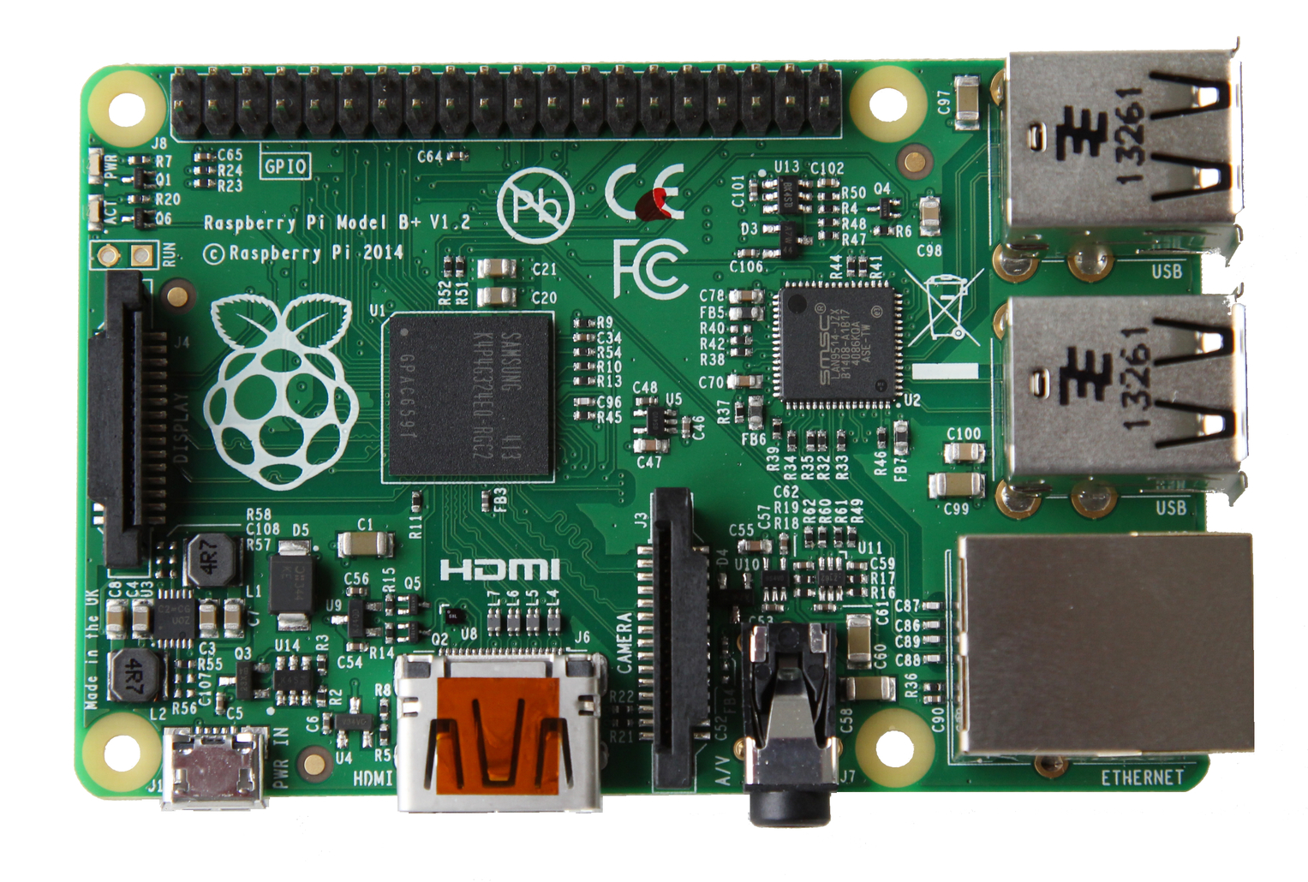


System Overview
Controller
Desktop Application
Robot

Slide 10


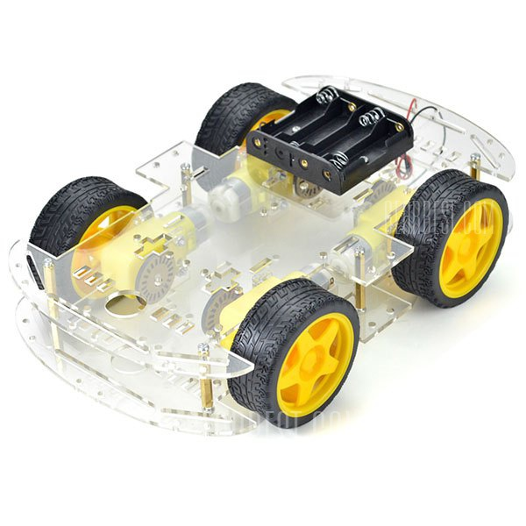
System Overview

Slide 11
Hardware Specification
Raspberry PI
IR Sensor
3-axis Accelerometer sensor
Batteries
DC Motors
Motor Driver L298N
Buttons
Microphone
Ultrasonic Sensor
LED’s

Slide 12


Software Specification
Qt Creator 4.0.2 Based on Qt 5.7.0
Buildroot

Slide 13
Block Diagram

Slide 14
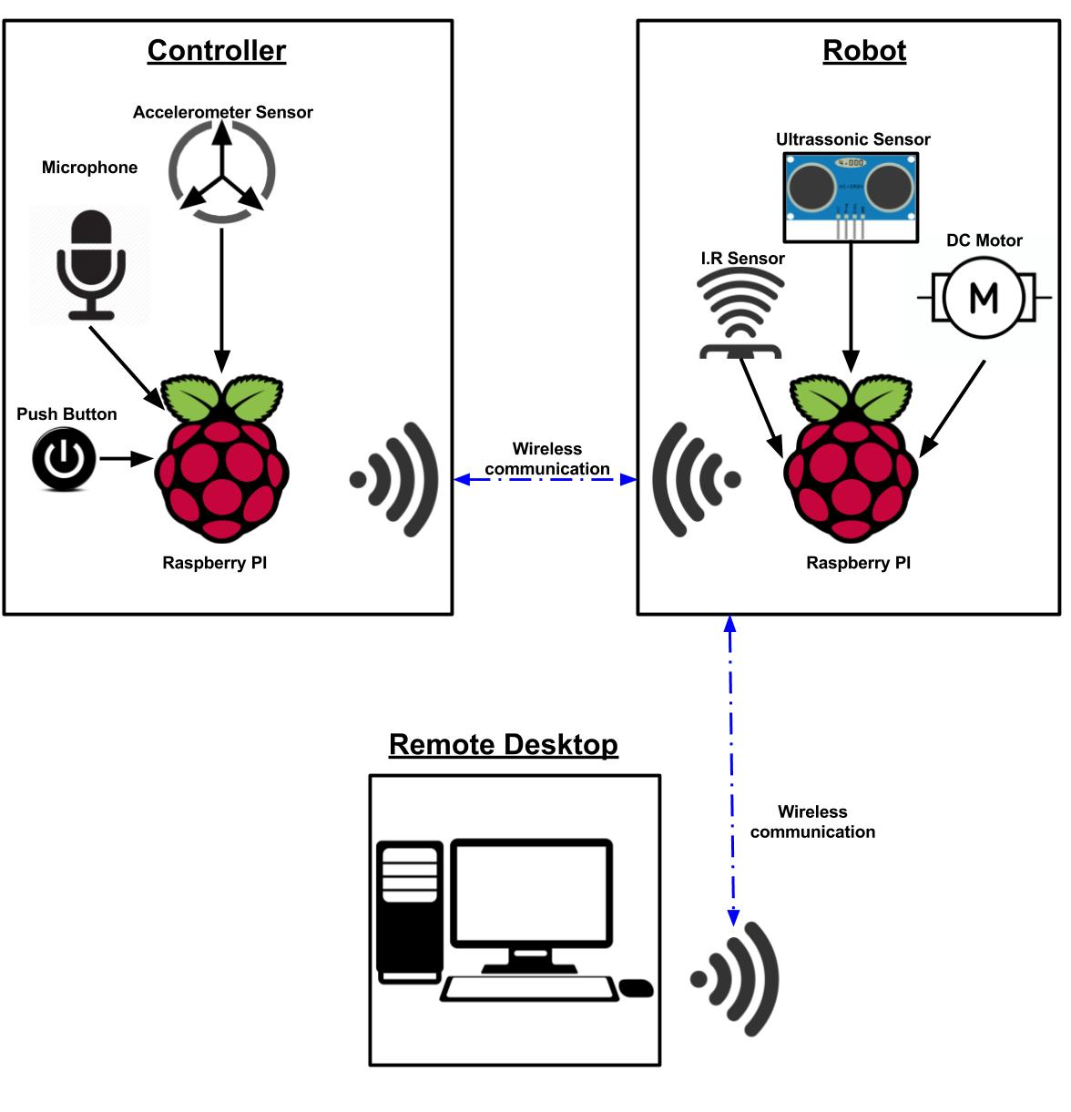
System Architecture

Slide 15
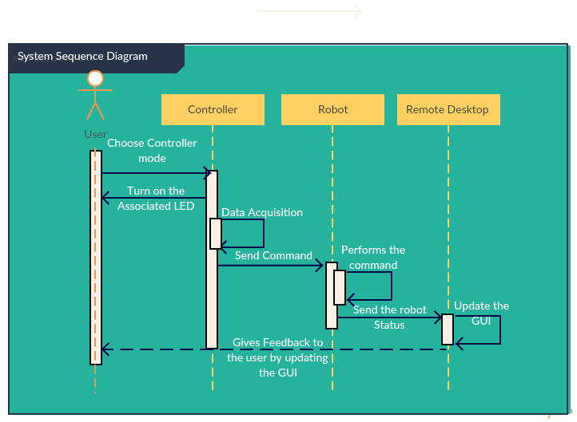
System Sequence Diagram

Slide 16
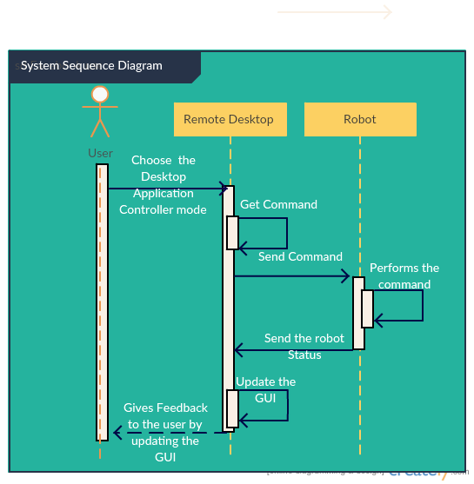
System Sequence Diagram

Slide 17
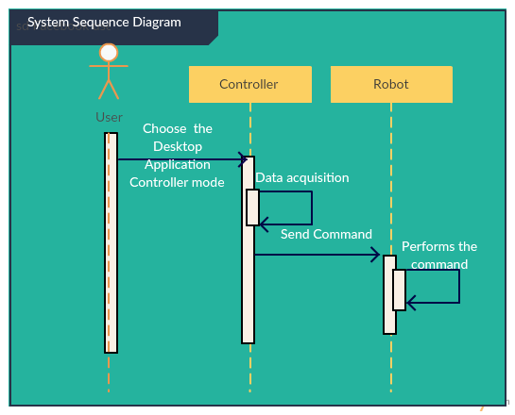
System Sequence Diagram

Slide 18
Use Cases
Controller

Slide 19
Use Cases
Robot

Slide 20
Use Cases
Desktop Application

Slide 21
Controller
Events
EVENT | RESPONSE | ACTOR | TYPE
Press Button | Send start/stop information to robot | User | Asynchronous
Updated accelerometer information | Read and Send accelerometer information to robot | Controller | Synchronous
Say command | Update commands information | User | Asynchronous
Command detected | Send command to robot | Controller | Asynchronous

Slide 22
Robot
Events
EVENT | SYSTEM RESPONSE | ACTOR | TYPE
Front obstacle detected | Prevent the robot to move forward; Buzzer alert | Robot | Asynchronous
Back obstacle detected | Prevent the robot to move back; Buzzer alert | Robot | Asynchronous
Receive Start/Stop information | Start the robot if it is stopped or stop if it is moving | Controller | Asynchronous
Receive accelerometer information | Move the robot accordingly to accelerometer information | Controller | Synchronous
Receive control data | Move the robot accordingly to control data | Desktop application | Asynchronous
Receive voice information | Move the robot accordingly to voice commands | Controller | Synchronous
Updated sensors information | Send sensors data to desktop application | Robot | Synchronous

Slide 23
Desktop Application Events
EVENT | RESPONSE | ACTOR | TYPE
Updated control information | Send control information to robot | Desktop application | Asynchronous
Direction selection | Updates control information | User | Asynchronous
Updated sensors information | Shows the sensors information | Desktop application | Synchronous

Slide 24
State Diagram Controller

Slide 25
State Diagram
Robot

Slide 26
State Diagram
Desktop Application

Slide 27
Technology Stack

Slide 28
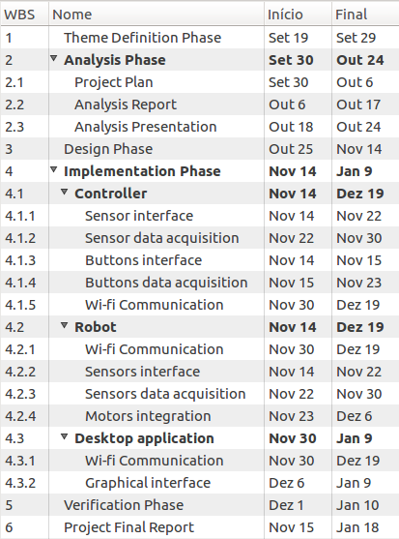
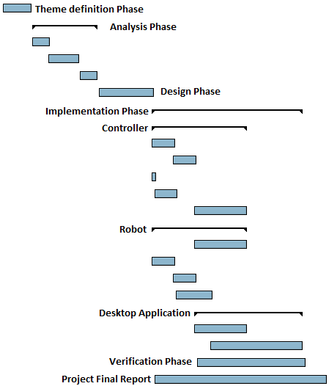
Gantt Diagram

Slide 29

Questions?

